Slide 1
Thread pool internals

Slide 2
.NET 4 really does make a difference.
For most applications the upgrade to the new 4.0 thread pool should be transparent and a performance gain should be spotted without changing line of code.
Machine | .NET 3.5 | .NET 4 | Improvement
A dual-core box | 5.03 seconds | 2.45 seconds | 2.05x
A quad-core box | 19.39 seconds | 3.42 seconds | 5.67x
The benchmark runs 10 million empty work items concurrently in order to calculate the thread pool overhead.

Slide 3
.NET 4.5 really does make a difference.
x86 avg time x86 Task size x64 avg time x64 Task size
.NET 4 10 ms 44 bytes 12 ms 80 bytes
.NET 4.5 8 ms 40 bytes 10 ms 72 bytes
Improvement 20% 9% 17% 10%
CreateTasks performance comparison, ntasks=100000, iterations=25

Slide 4

Lock-free updates
x = x * 10;

Slide 5
Atomic Operation
data ++;
Load from RAM into CPU register
Increment CPU register
Store from CPU register into RAM.
Notes:
An operation during which a processor can simultaneously read a location and write it in the same bus operation. This prevents any other processor orI/O device from writing or reading memory until the operation is complete.
so an atomic operation must be performed entirely or not performed at all.
An atomic operation is a sequence of one or more machine instructions that are executed sequentially, without interruption. By default, any sequence of two or more machine instructions isn't atomic since the operating system may suspend the execution of the current sequence of operations in favor of another task. If you want to ensure that a sequence of operations is atomic you must use some form of locking or other types of synchronization. Without that, the only guarantee you have is that a single machine instruction is always atomic -- the CPU will not interrupt a single instruction in the middle. We can conclude from that minimal guarantee that if you can prove that your compiler translates a certain C++ statement into a single machine instruction, that C++ statement is naturally atomic meaning, the programmer doesn't have to use explicit locking to enforce the atomic execution of that statement.

Slide 6
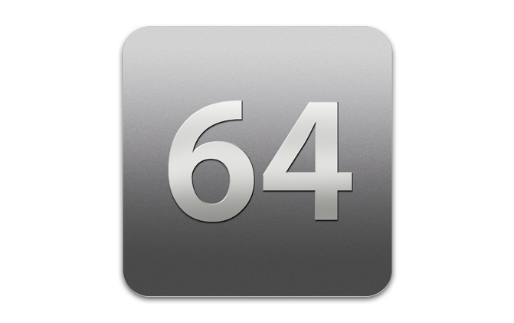
Reading and writing 64-bit fields is non atomic on 32-bit environments because it requires two separate instructions: one for each 32-bit memory location.

Slide 7
Interlocked
Increment
Decrement
Add
value can be a negative number allowing subtraction
Read
performs an atomic Read on a 64-bit field:
old val = Exchange(ref _sum, new val)
Write a 64-bit field while reading previous value
CompareExchange(ref _sum,new val, old val)
Update a field only if it matches a certain value
enables lock-free read-modify-write operations

Slide 8
Lock-free updates
Take a “snapshot” of x into a local variable
Calculate the new value
Write the calculated value back if the snapshot is still up-to-date using Interlocked.CompareExchange
If the snapshot was stale, spin and return to step 1

Slide 9
Thread-safe collections
ConcurrentBag<T>
ConcurrentStack<T>
ConcurrentQueue<T>
ConcurrentDictionary<TKey,Tvalue>
Notes:
IProducerConsumerCollection<T> represents a collection that allows for thread-safe adding and removing of data. BlockingCollection<T> is used as a wrapper for an IProducerConsumerCollection<T> instance, allowing removal attempts from the collection to block until data is available to be removed. Similarly, a BlockingCollection<T> can be created to enforce an upper-bound on the number of data elements allowed in the IProducerConsumerCollection<T>; addition attempts to the collection may then block until space is available to store the added items. In this manner, BlockingCollection<T> is similar to a traditional blocking queue data structure, except that the underlying data storage mechanism is abstracted away as an IProducerConsumerCollection<T>.

Slide 10
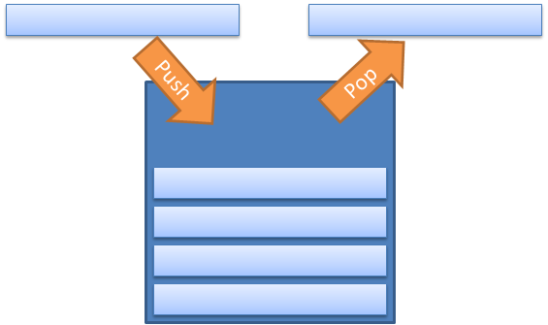
Concurrent Stack

Slide 11

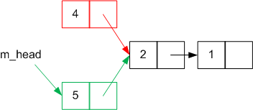
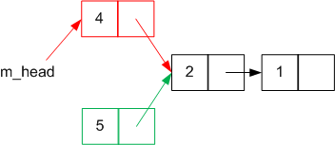
Adding a item to stack
Create a new Node object to hold the new value
Setting the node's m_next variable to point to the current head node
Changing m_head to point to the newly-created node.
Thread 1, cycle 1 ,
executes 1,2
Thread 2, cycle 2 ,
executes 1,2,3
Thread 1, cycle 3 ,
executes 3
Notes:
The node successfully pushed by Thread 2 has disappeared from the stack.

Slide 12
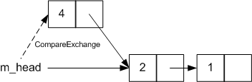
Adding a item to Concurrent Stack
public void Push(T item)
{
Node node = new Node(item); //step 1
do {
node.m_next = m_head; //step 2
} while (
Interlocked.CompareExchange(ref m_head, node, node.m_next) != node.m_next); //step 3
}
Perform step 3 only if the head hasn't changed in the meantime. If it has been changed, then go back to step 2 to use the updated head node as the value of m_next.
Notes:
what we want to do isThis has eliminated the race condition we had between steps 2 and 3. Only if the head hasn't been changed is the new node pushed onto the stack as the new head. This loop repeats until CompareExchange successfully sets the head to the new node.
Performing atomic operations
So, what underlying aspects of the system let us perform these operations atomically?
Object references are atomic This lets us take an atomic snapshot of the current state simply by storing the value of m_head in a local variable; m_head will always be pointing at a valid node (or null), it won't be 'half-changed'.
Interlocked.CompareExchange is atomic This ensures the state-check-and-switch won't be afflicted by race conditions with other threads.
m_head is a volatile variable m_head is marked as volatile. This means that any changes to that variable by one thread are instantly visible to all other threads on the system; there's no caching to get in the way. Any threads that are attempting to modify m_head will be forced to try again, and they won't overwrite the changes already made.

Slide 13
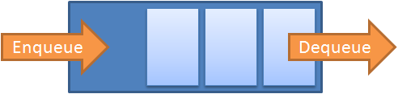
ConcurrentQueue
Notes:
More specifically, it needs to be a linear array with a (conceptually) infinite capacity - although there will only be a finite number of items stored in the queue, items can be enqueued and dequeued an unlimited number of times.

Slide 14
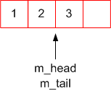
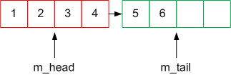
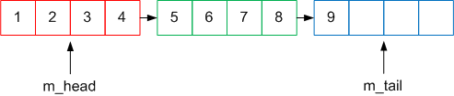
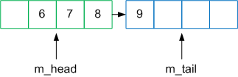
ConcurrentQueue
three items are enqueued
Three more items are then enqueued
And another three
Five items are then dequeued from the head.
Notes:
Using this method, the illusion of an infinite linear array can be created using a finite number of segments.
Note m_head point to first segment not node.
|||,ly m_tail points to last segment not node.

Slide 15
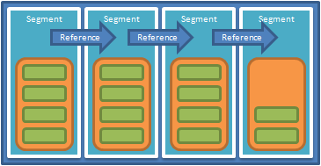
ConcurrentQueue
private class Segment {
volatile T[] m_array;
volatile int m_high; // the index items to be added
volatile int m_low; // the index items to be removed
}
Notes:
However, you don't need to keep the entire infinite array in memory, you only need the section of the array that is actually storing items. By splitting the array into finite segments you can create and discard segments as items get enqueued and dequeued to the queue. when one segment is filled up (currently 32 is the number of items per segment) and a new item is put into the queue, a new segment is allocated and the item is placed in that segment.

Slide 16
ConcurrentQueue
Increment the m_high variable. This is now the index the item should be inserted at.
Assign the item to the specified slot in m_array.
public void Enqueue(T item)
{
int insertIndex = Interlocked.Increment(ref m_high);
m_array[insertIndex] = item;
}
Notes:
http://geekswithblogs.net/simonc/archive/2012/01/24/inside-the-concurrent-collections-concurrentqueue.aspx
If step 1 can be done atomically, returning the new incremented value, that gives each thread trying to enqueue an item at the same time separate slots. Step 2 can then be performed concurrently by each thread without having to worry about conflicts.
Dequeuing acts in a similar way to enqueuing:
Increment the m_low variable. The previous index is the index of the item to be dequeued.
Return the item stored at the specified slot in m_array.
public T Dequeue() { // Increment returns the incremented value of the variable int index = Interlocked.Increment(ref m_low); return m_array[index-1]; }
if each thread trying to dequeue an item can be atomically 'assigned' a slot by performing step 1 using Interlocked.Increment, then step 2 can be performed concurrently by several threads:

Slide 17
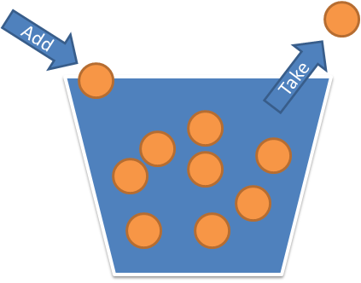
ConcurrentBag
a thread-safe, unordered collection of objects
Notes:
The ConcurrentBag<T> is one of the most simple concurrent types which has been introduced. It is a typical bag data structure (also known as a multiset), meaning that it is an unordered collection of items that allows duplicates.
Two final operations that you can perform on the ConcurrentBag are to check to see if it is empty and to check the number of items currently contained inside it. These are performed using the IsEmpty and Count properties respectively. I would explain these, but I think that you can probably figure them out. It is worth noting that with multi-threaded implementations of ConcurrentBag, you can’t rely on the results of these operations, since in the time between when you check and when you perform an operation, another thread could have added or removed items.
You can think of ConcurrentBag<T> as a thread-safe linked list of thread-safe double-ended queues (deques). Each thread that touches the bag has it’s own deque to which it adds and removes items from the top. When any thread’s deque is empty, it pulls from the bottom of another thread’s non-empty deque. You can see why this is scalable and efficient: in many cases, there is no contention at all. Contention is only an issue when a thread does not have any items and is forced to “steal” items from another thread. It’s worth noting that the add-to-the-top-steal-from-the-bottom approach plays nice with the cache: threads get to work on items in nice contiguous chunks. In fact, this type of work-stealing queue works so well that it’s principally how the Thread Pool in .NET 4.0 load-balances work.
Just to make it clear, ConcurrentBag<T> isn’t always the fastest choice. Consider the single producer/single consumer scenario: the producer would always steal from the consumer’s deque – ConcurrentQueue<T> would be much more efficient. Scenarios in which threads both produce and consume values will benefit from ConcurrentBag<T> the most.

Slide 18
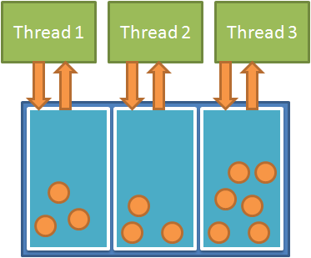
concurrent bag
if local queue is empty, it will then perform some locking and look at one of the queues from another thread.
Notes:
The ConcurrentBag is optimized for multiple threads to all be adding and removing items at the same time. Because of this, internally the ConcurrentBag keeps a local queue of items for each thread that is accessing it. This is done using an internal type called ThreadLocalList. This way, when multiple threads are accessing the bag, when they are hitting their own queue, no locking needs to happen since only one thread is accessing it. However, if one thread goes to take an item and finds that its local queue is empty, it will then perform some locking and look at one of the queues from another thread in order to try to find an item. In this way, if each thread is pushing and consuming its own items then you can get very high throughput with no locking. People will often refer to this as a "work stealing algorithm", since once a thread finishes up its own items, it will try to steal items from other threads queues.

Slide 19
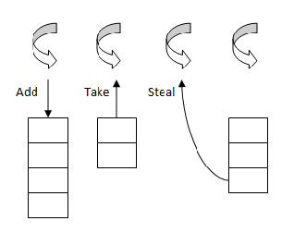
concurrent bag
Notes:
that it’s principally how the Thread Pool in .NET 4.0 load-balances work.

Slide 20

Which Data Structure should I use for single producer/single consumer scenario?
Notes:
Consider the single producer/single consumer scenario: the producer would always steal from the consumer’s deque – ConcurrentQueue<T> would be much more efficient.

Slide 21

2.0 Thread Pool
Process
1 thread pool per process
Global
Queue
CLR Thread Pool
Worker Thread 1
Worker Thread p
…
Program Thread
With more threads competing for work items, it is not optimal to put up with the contention issues of a single queue that all of them are trying to access safely.
Notes:
A way to think of the CLR thread pool and how it gets used, e.g. when you call ThreadPool.QueueUserWorkItem, is to picture a global queue where work items (essentially delegates) get queued on a global queue and multiple threads pick them out in a First In First Out order. The FIFO order is not something that is documented or guaranteed, but my personal guess is that too many applications rely on it, so I don’t see it changing any time soon. The image on the left shows the main program thread as it is creating a work item; the second image shows the global thread pool queue after code has queued 3 work items; the third image shows 2 threads from the thread pool that have grabbed 2 work items and executing them. If in the context of those work items (i.e. from the executing code in the delegates) more work items get created for the CLR thread pool they end up on the global queue (see image on the right) and life goes on. In previous versions the ThreadPool queue was implemented as a linked list protected by a big lock - the new version of the queue is based on the new array-style, lock-free, GC-friendly ConcurrentQueue<T> class.

Slide 22
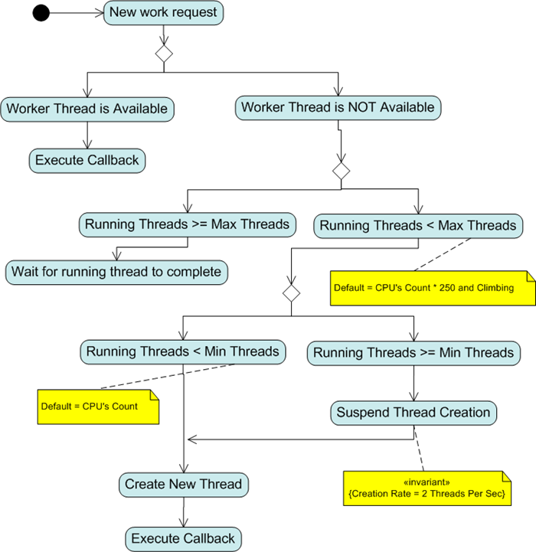
Notes:
Increasing the thread pool’s minimum thread count to x doesn’t actually force x threads to be created right
away—threads are created only on demand. Rather, it instructs the pool manager to create up to x threads the
instant they are required. The question, then, is why would the thread pool otherwise delay in creating a thread
when it’s needed?
The answer is to prevent a brief burst of short-lived activity from causing a full allocation of threads, suddenly
swelling an application’s memory footprint. To illustrate, consider a quad-core computer running a client
application that enqueues 40 tasks at once. If each task performs a 10 ms calculation, the whole thing will be
over in 100 ms, assuming the work is divided among the four cores. Ideally, we’d want the 40 tasks to run on
exactly four threads:
· Any less and we’d not be making maximum use of all four cores.
· Any more and we’d be wasting memory and CPU time creating unnecessary threads.
And this is exactly how the thread pool works. Matching the thread count to the core count allows a program to
retain a small memory footprint without hurting performance—as long as the threads are efficiently used
(which in this case they are).
But now suppose that instead of working for 10 ms, each task queries the Internet, waiting half a second for a
response while the local CPU is idle. The pool manager’s thread-economy strategy breaks down; it would now
do better to create more threads, so all the Internet queries could happen simultaneously.
Fortunately, the pool manager has a backup plan. If its queue remains stationary for more than half a second, it
responds by creating more threads—one every half-second—up to the capacity of the thread pool.
The half-second delay is a two-edged sword. On the one hand, it means that a one-off burst of brief activity
doesn’t make a program suddenly consume an extra unnecessary 40 MB (or more) of memory. On the other
hand, it can needlessly delay things when a pooled thread blocks, such as when querying a database or calling
WebClient.DownloadFile. For this reason, you can tell the pool manager not to delay in the allocation of the
first x threads, by calling SetMinThreads, for instance:
ThreadPool.SetMinThreads (50, 50);
(The second value indicates how many threads to assign to I/O completion ports, which are used by the APM,
described in Chapter 23 of C# 4.0 in a Nutshell.)
The default value is one thread per core

Slide 23
CLR 4 Thread Pool
Task thread as local q &
work stealing capability
CLR Thread Pool: Work-Stealing
Task, QueueUserWorkerItem
Share same pool.
Local
Queue
Local
Queue
Global
Queue
…
Worker Thread 1
Worker Thread p
…
Task 6
Task 4
Task 3
Task 1
Program Thread
Task 5
Task 2
In addition to the single global queue, each thread in the thread pool has its own local queue:
Notes:
When a thread-pool thread is ready for more work, it first looks at the head of its local queue, then in the global queue, and then in the tail of local queues of other threads.
In CLR 4, the thread pool engine has had some improvements made to it (it has been having positive tweaks in every release of the CLR) and part of these improvements are some performance gains that are achievable when using the new System.Threading.Tasks.Task type. I'll show a code example in another post, but you can think of creating and starting a Task (passing it a delegate) as the equivalent of calling QueueUserWorkItem on the ThreadPool. A way to visualize the CLR thread pool when used via the Task-based API is that,
Just as with normal thread pool usage, the main program thread may create Tasks that will get queued on the global queue (e.g. Task1 and Task2) and threads will grab those Tasks typically in a FIFO manner. Where things diverge is that any new Tasks (e.g. Task3) created in the context of the executing Task (e.g. Task2) end up on a local queue for that thread pool thread. Why Local Queues With the era of manycore machines upon us and devs taking advantage of parallelism, the number of threads in the thread pool is likely to increase: at a minimum equal to the number of cores for compute bound operations, and likely more due to injection of additional threads as a result of IO bound operations or blocking calls stalling the CPU. Bottom line: more cores = more threads. With more threads competing for work items, it is not optimal to put up with the contention issues of a single queue that all of them are trying to access safely. This would be amplified by the goal of fine grained parallelism where each work item finishes fairly quickly, so the trips to the global queue would be frequent. It is for this reason we introduce a local queue per thread, where additional tasks get queued (with no contention) and will then be retrieved by that same thread (again with no contention).

Slide 24
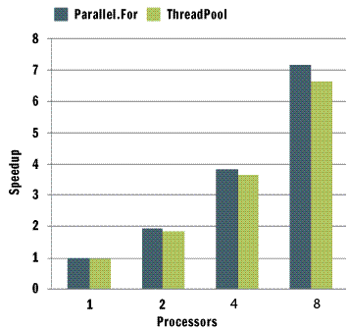
If your computer has a single CPU, the library pays a small penalty for breaking the tasks up and running them one at a time.
Notes:
Notice that on the single-core machine the Parallel version performs practically the same as the direct for loop.

Slide 25
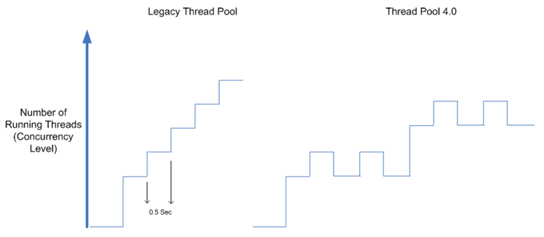
‘thread injection and retirement algorithm’
Determines the optimal number of threads by looking at the machine architecture, rate of incoming work and current CPU utilization
Notes:
. The default task scheduler is based on the .NET Framework 4 ThreadPool, which provides work-stealing for load-balancing, thread injection/retirement for maximum throughput
Determines the optimal number of threads by looking at the machine architecture, rate of incoming work and current CPU utilization across the entire machine (using daemon thread that runs in the background and periodically monitor the CPU)."
In addition, to avoid unnecessary starvation a demons thread is running in the background and periodically monitors the CPU – in case of low CPU utilization it creates new threads as appropriate.

Slide 26

Local queue feature only applies when working with the Task Parallel Library

Slide 27
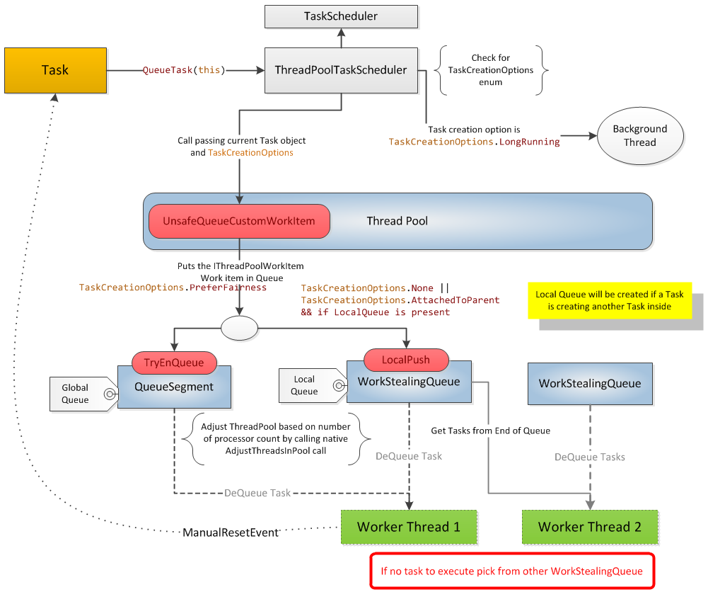
Notes:
The Task class implements the IThreadPoolWorkItem interface, which is responsible for executing work items from the thread pool queue.
The ThreadPoolTaskScheduler class pushes Tasks (IThreadPoolWorkItem) to a global queue using the ThreadPool API.
Worker threads picks up the tasks from Global Queue (QueueSegment).
Once the processing is done, it informs the task by calling the manual reset event of System.Threading.
If a task is created within a task, then it will not be pushed to the Global Queue, but instead maintained in a local queue (work stealing queue).
The worker thread looks first into the local queue; if there is no work item to pick, then it searches the global queue. Still, if there is no work for the thread, it will look for any pending work item in other queues. So during the task processing, none of the threads are sitting idle, which actually gives 100% utilization of all cores of machines.
Any task item in the work stealing queue can be shared by any other worker thread.

Slide 28

When a parent task schedule tasks, the child tasks don’t get queue in the global queue, rather they’re being queued in a local queue dedicated to the parent task.

Slide 29
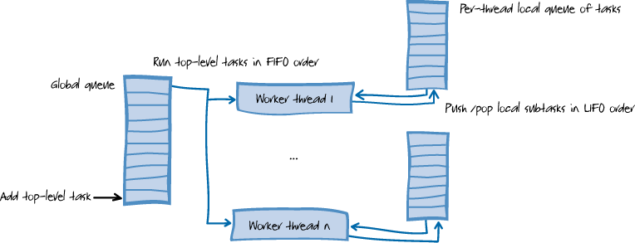
any work that comes from a thread that is not one of the thread pool's worker threads still has to be placed on the global queue, which always incurs heavier synchronization costs than adding to a local queue.

Slide 30
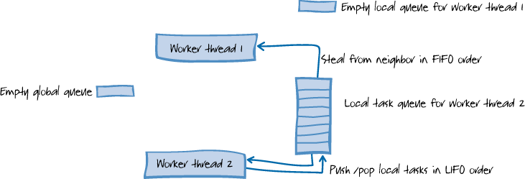
A work-stealing queue is a double-ended queue that has a private end and a public end. The queue allows lock-free pushes and pops from the private end but requires costlier synchronization for operations at the public end.
Notes:
When the queue gets small so private and public operations could conflict, synchronization is necessary.
When the length of the queue is small, synchronization is required from both ends due to the locking strategy used by the implementation.
If a thread is free and there are no tasks in its local queue and also global queue, then it will steal work from other threads. This ensures that all cores are optimally utilized. This concept is called 'work stealing'.
The diagram shows that when a thread has no items in its local queue, and there are also no items in the global queue, the system "steals" work from the local queue of one of the other worker threads.

Slide 31

2.0 thread pool coexist with 4.0 in case side by side execution

Slide 32

The local queuing feature can be disabled by including the PreferFairness flag in the TaskCreationOptions of the parent
Notes:
task (this flag is not included by default); with the PreferFairness flag set – the scheduler will still enqueue the child task to the global queue rather than to the local queue.

Slide 33

After a thread finish its destroyed only after spending 10 seconds (was 40 seconds) on the pool doing nothing.

Slide 34
ParallelExtensionsExtras
if you require special functionality, you can create a custom scheduler and enable it for specific tasks or queries.
http://blogs.msdn.com/b/pfxteam/archive/2010/04/04/9990342.aspx
Notes:
The TaskSchedulers folder within the ParallelExtensionExtras projects provides the following 13 classes:
ConcurrentExclusiveInterleave.cs. The ConcurrentExclusiveTaskScheduler class provides a scheduler shim used to queue tasks to an interleave and execute these tasks on request of the interleave.
CurrentThreadTaskScheduler.cs. The CurrentThreadTaskScheduler class provides a task scheduler that runs tasks on the current thread.
IOCompletionPortTaskScheduler.cs. The IOCompletionPortTaskScheduler class offers a task scheduler that uses an I/O completion port in order to control concurrency. It is necessary to set the maximum number of threads in the scheduler to be executing concurrently and the number of threads to have available in the scheduler for executing tasks.
IOTaskScheduler.cs. The IOTaskScheduler class provides a task scheduler that targets the I/O ThreadPool.
LimitedConcurrencyLevelTaskScheduler.cs. TheLimitedConcurrencyLevelTaskScheduler class offers a task scheduler that ensures a maximum concurrency level while running on top of the ThreadPool. It is necessary to set the maximum degree of parallelism desired for this scheduler.
OrderedTaskScheduler.cs. The OrderedTaskScheduler class provides a task scheduler that ensures only one task is executing at a time. Tasks execute in the order that they were queued (FIFO). It is a subclass of LimitedConcurrencyLevelTaskScheduler that sends 1 as a parameter for its base class constructor.
QueuedTaskScheduler.cs. The QueuedTaskScheduler class offers a task scheduler that provides control over fairness, priorities and the underlying threads used. It offers many constructors with diverse number of parameters that allow you to control the threads to create and use for processing work items.
ReprioritizableTaskScheduler.cs. The ReprioritizableTaskScheduler class provides a task scheduler that supports changes in the priorities for previously queued tasks.
RoundRobinTaskScheduler.cs. The RoundRobinTaskSchedulerQueue class offers a task scheduler that works with round-robin scheduling.
StaTaskScheduler.cs. The StaTaskScheduler class provides a task scheduler that uses STA (short for Single-Threaded apartment) threads in order to support the execution of tasks. It is necessary to set the maximum number of threads desired for this scheduler.
SynchronizationContextTaskScheduler.cs. The SynchronizationContextTaskSchedulerclass offers a task scheduler that targets a specific SynchronizationContext specified as a parameter in its constructor.
ThreadPerTaskScheduler.cs. The ThreadPerTaskScheduler class provides a task scheduler that dedicates one thread per task.
WorkStealingTaskScheduler.cs. The WorkStealingTaskScheduler class offers a work-stealing task scheduler. Its default parameters specify twice as many threads as there are processors to support the execution of tasks. However, it is also possible to specify the number of threads to use in the scheduler.

Slide 35

Clr Management Thread
Main Thread
Foreground Thread
Worker Thread
Thread, Task
User Interface Thread
Thread, Task
Background Thread
Worker Thread
Thread, Task
I/O Thread
APM, EAP, TAP
Thread Pool Thread
Worker Thread
Task, ThreadPool, Delegate.BeginInvoke, BackgroundWorker
Data Partitioning
Parallel
Data Partitioning and Aggregation
Plinq
Asynchrony
APM, EAP, TAP

